Slide 1
Paper Sharing
Presenter: Yuan-Jye Chen
2023/10/12

Slide 2
References
Kousias, Konstantinos, et al. "Implications of handover events in commercial 5G non-standalone deployments in Rome." Proceedings of the ACM SIGCOMM Workshop on 5G and Beyond Network Measurements, Modeling, and Use Cases. 2022.
Fiandrino, Claudio, David Juárez Martínez-Villanueva, and Joerg Widmer. "Uncovering 5G performance on public transit systems with an app-based measurement study." Proceedings of the 25th International ACM Conference on Modeling Analysis and Simulation of Wireless and Mobile Systems. 2022.

Slide 3
Outline
Background
Implications of handover events in commercial 5G non-standalone deployments in Rome (1st paper)
Methodology I
Results & Observations I
Uncovering 5G performance on public transit systems with an app-based measurement study (2nd paper)
Methodology II
Results & Observations II
Comparison & Conclusions
Authors

Slide 4
Background

Slide 5
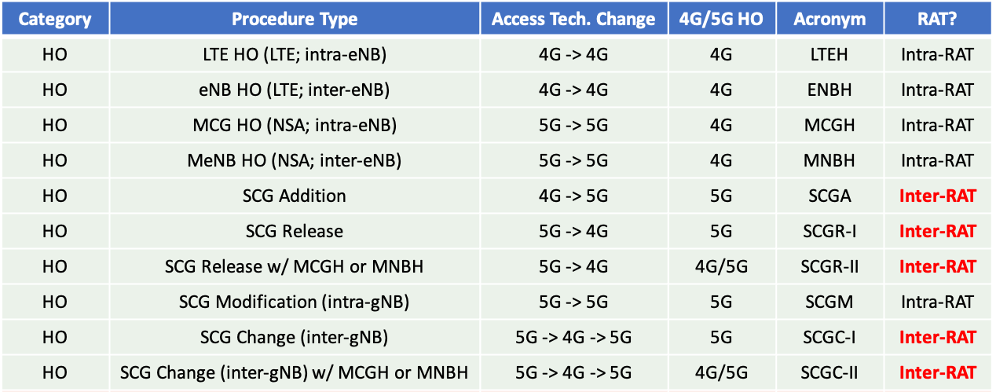
Handover
NSA Structure: Data Plane (4G/5G), Control Plane (4G)
4G/5G Radio Access Technology (RAT)
Intra-RAT (horizontal) HO: UE is instructed to redirect its data plane from a 4G cell to another 4G cell, or from a 5G cell to another 5G cell.
Inter-RAT (vertical) HO: UE is instructed to rearrange its data plane by either adding a connection to a 5G cell, or removing a previously used 5G connection.

Slide 6
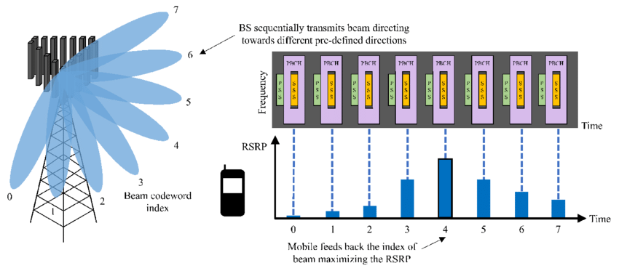
SSB Beamforming
Based on beam sweeping and measurement feedback, UE is instructed to select the optimal pair of transmit and receive beams.
In the first paper, the term "PCI-SSB beam," for example, 148-1, is used to denote the PCI and SSB beam pair with which the UE connects.
https://www.researchgate.net/figure/Illustration-of-beam-management-in-5G-NR-SSB-consisting-of-the-primary-synchronization_fig1_363331719

Slide 7
Methodology I

Slide 8
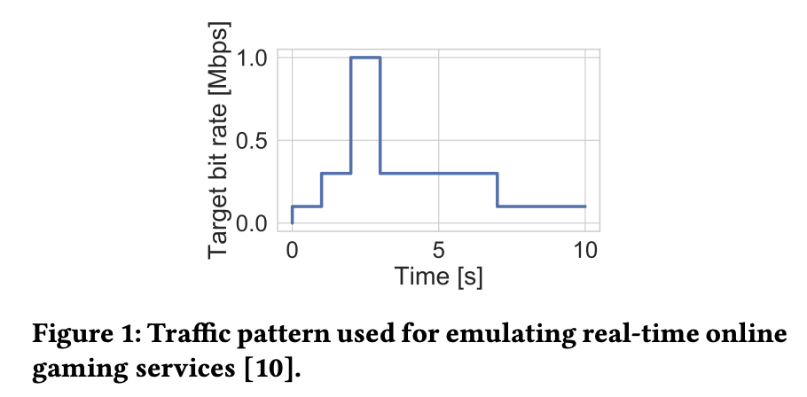
Methodology
Sites: Rome (羅馬), Italy
Scenario: Outdoor Walking (OW), Outdoor Driving (OD)
Radio Access Tech: 4G (1, 3, 7, and 20); 5G (n78)
Tools | Purpose
Samsung Galaxy S20 | Commercial 5G-capable device (active measurement)
Rohde & Schwarz (R&S) TSMA6 toolkit | Detect and decode downlink control information (passive measurement)
A real-time online gaming application was emulated through the traffic pattern shown in Figure 1.

Slide 9
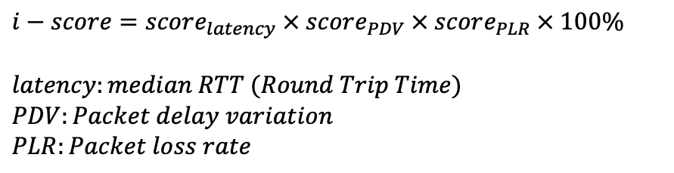
Interactivity Score (metric)
The higher i-score means the better performance.
$$i−score=score_{latency} × score_{PDV} × score_{PLR} × 100\%$$
$$latency:median RTT (Round Trip Time)$$
$$PDV:Packet delay variation$$
$$PLR:Packet loss rate$$
https://www.rohde-schwarz.com/us/solutions/test-and-measurement/mobile-network-testing/stories-insights/article-interactivity-test-concept-and-kpis-part-2-_253245.html

Slide 10
Results & Observations I

Slide 11
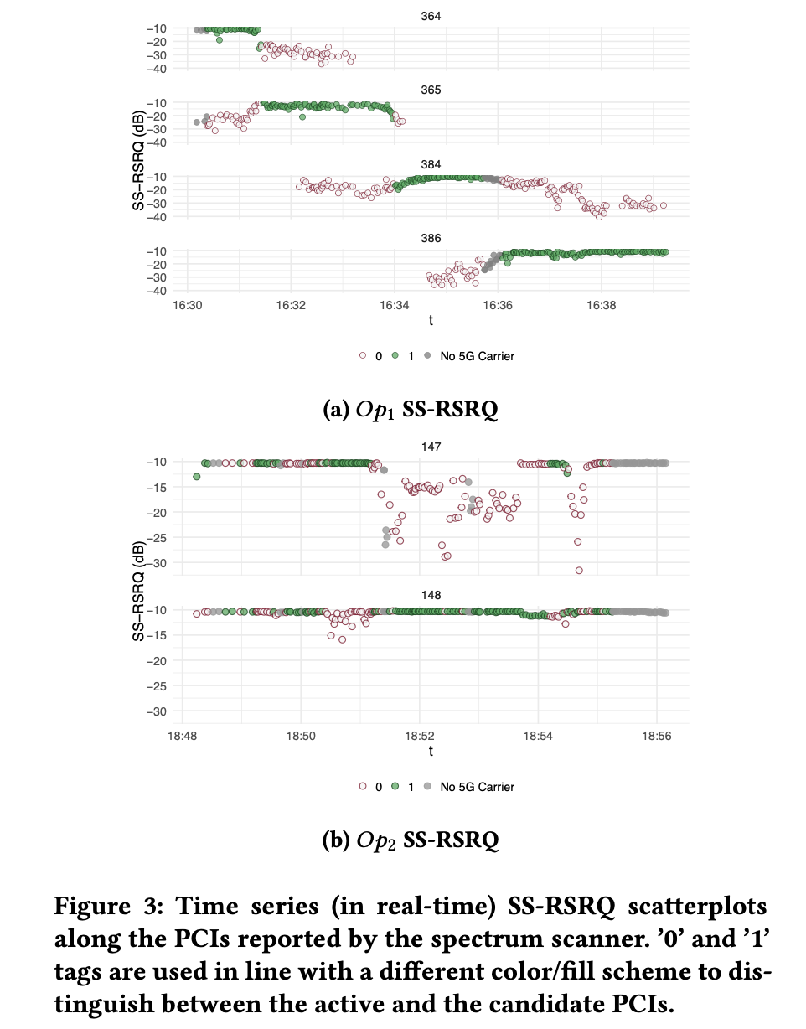
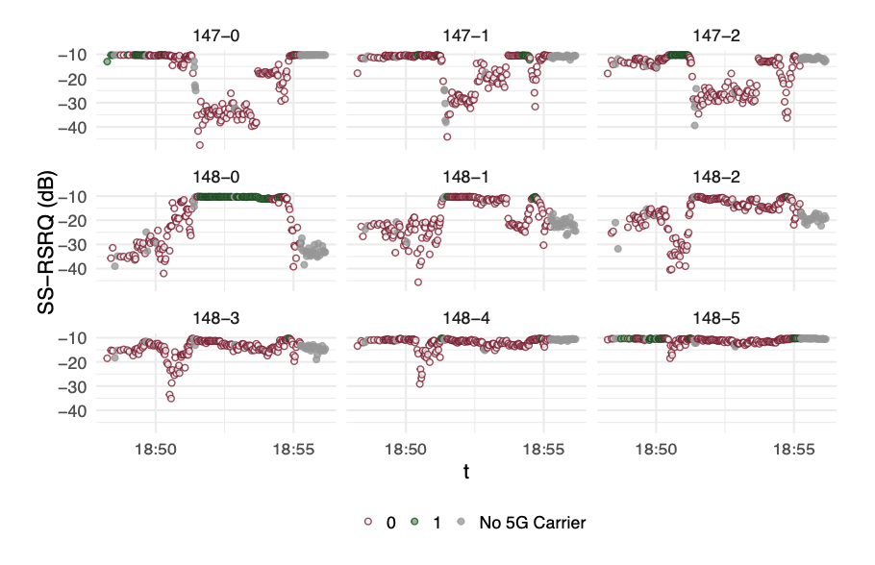
Time Series (Data) Visualization
Use different color/fill scheme to distinguish between the PCI used by the UE (green) and the candidate PCIs (red).
Observation: UE tends to be redirected to the PCI offering the best SS-RSRQ!!
5G PCI-SSB
5G PCI

Slide 12
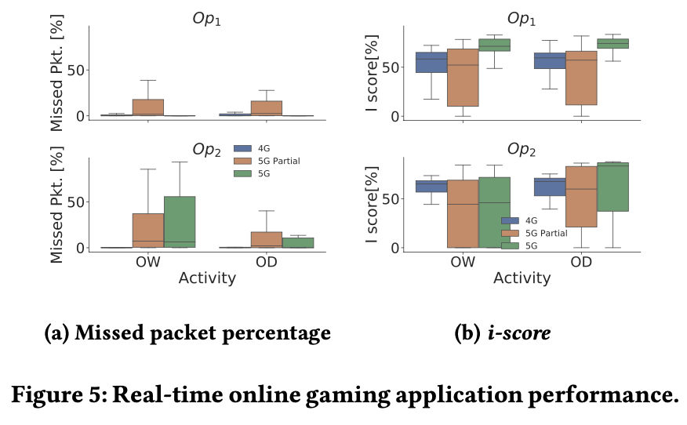
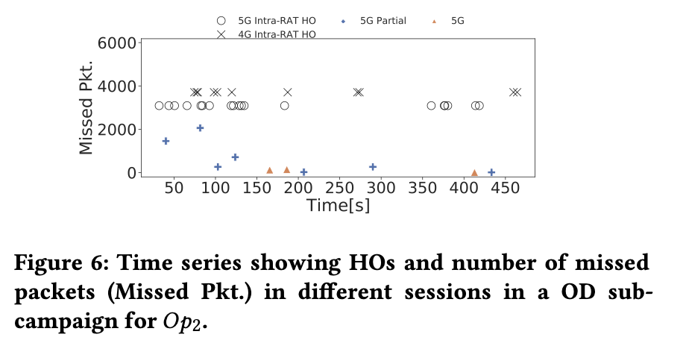
Comparison: Different scenarios and operators
5G Partial means there is at least one inter-RAT HO from 4G to 5G in the session.
Figure 5: For both operators, the worst median i-score is experienced during 5G Partial sessions.
Figure 6: 5G Partial sessions suffer a higher number of missed packets compared to 5G sessions.
Records the number of missed packet in each second.

Slide 13
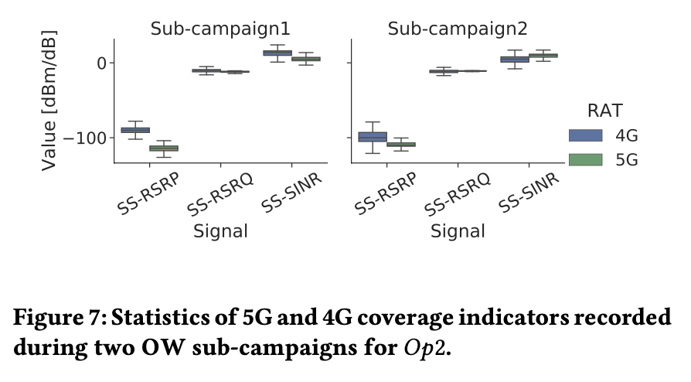
Comparison: Two sub-campaigns under the same scenario and operator
5G coverage indicators (SS-RSRP, SS-RSRQ, SS-SINR) in Sub1 is worse than those in Sub2
For Sub1, the 4G coverage indicators are better than the 5G ones; for Sub2, 5G SS-SINR is slightly better than 4G SINR.
However, in both sub-campaigns, UE is instructed to perform an inter-RAT HO and connect to a 5G carrier.
Implication: The fact that inter-RAT HO policy under 5G NSA is not optimal (but may be sub-optimal) results in the worse performance.
 | Sub-campaign 1 | Sub-campaign 2
Avg PLR (%) | 38% (worse!!) | 11%
i-score (%) | 25% (worse!!) | 48%

Slide 14
Methodology II

Slide 15
Methodology
Sites: Madrid (馬德里), Spain
Scenario: The public bus transit system
Radio Access Tech: 4G; 5G mid-band (3.3-3.8 GHz, band n78) and low bands (700 MHz, n28)
Tools | Purpose
Xiaomi Mi Mix 3 5G, Xiaomi Mi 10, and Samsung Galaxy S20 Ultra 5G | Commercial 5G-capable device
MobileInsight | Collecting control- and user-plane protocol interactions (RRC messages)
5G tracker (developed by the University of Minnesota with a free license) | Record active and passive 5G measurements (radio type, CID, PCI, ARFCN, RSSI, RSRP, SINR, RSRQ, moving speed, throughput and latency with built-in iperf and ping tools)
GNetTrack (developed by Gyokov Solutions with a small one-off fee) | Similar to 5G tracker, and more stable during long recordings
Ookla’s Speedtest | Benchmark network throughput, latency, and video streaming quality

Slide 16
Results & Observations II

Slide 17
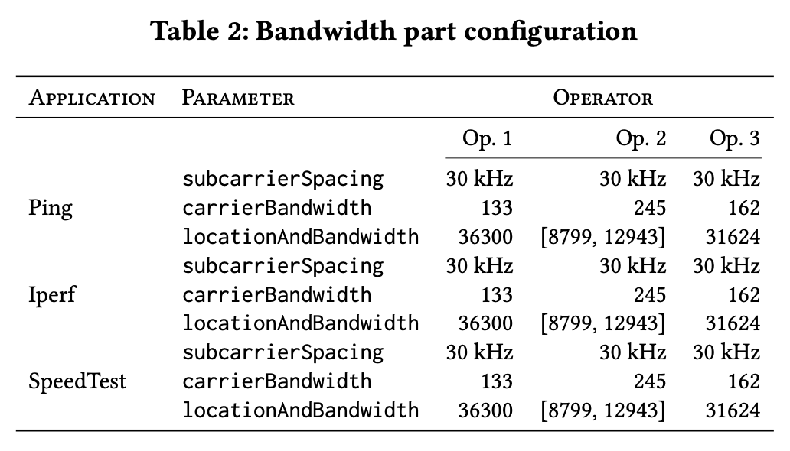
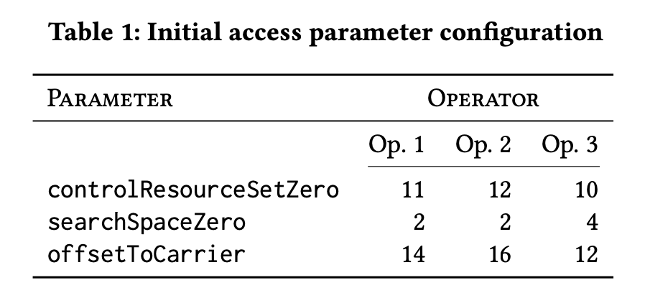
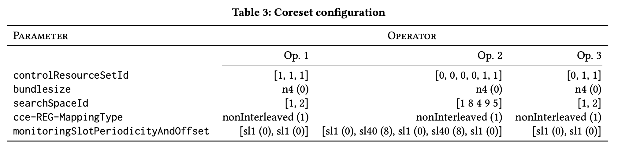
Network Configurations
Use MobileInsight (RRC OTA Packet) to detect parameters among different operators

Slide 18
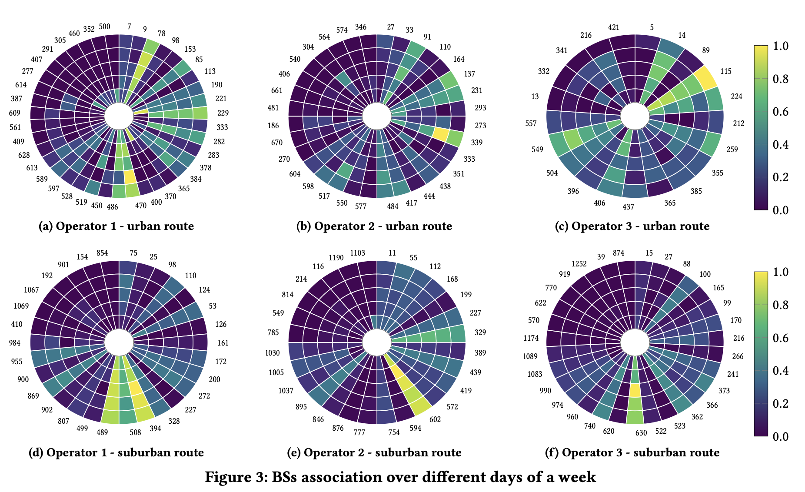
Connectivity
Implication: The mobile device attaches preferentially to the same BS under pre-determined routes.
The wheel chart show the normalized frequency of each connected BS on different days (the most inner- circles are Mondays, the most outer-circles are Fridays).
The status of frequently or infrequently seen BS holds across days.

Slide 19
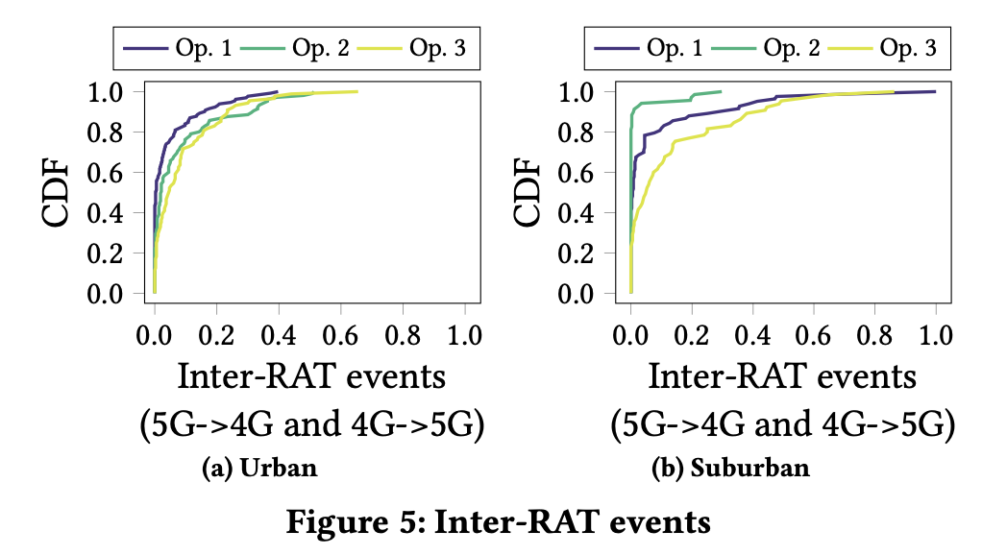
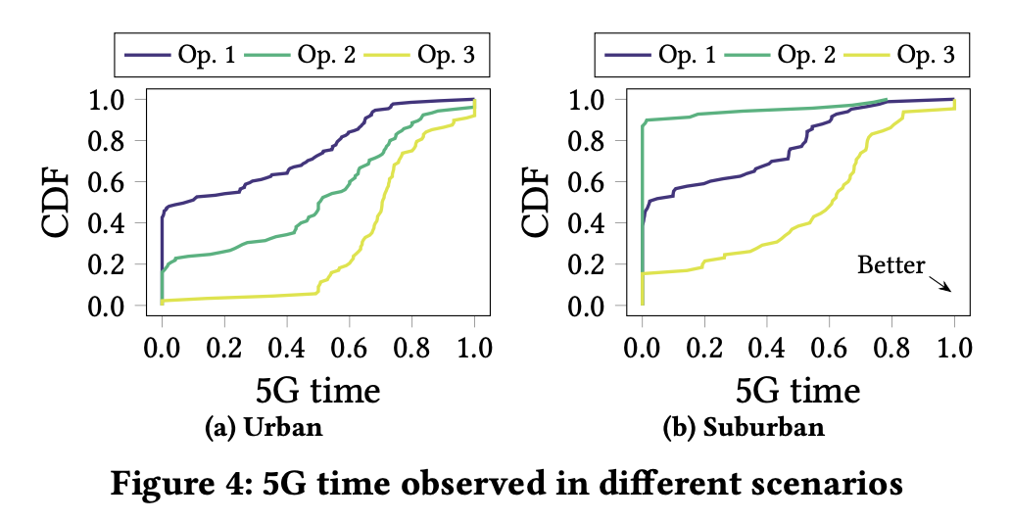
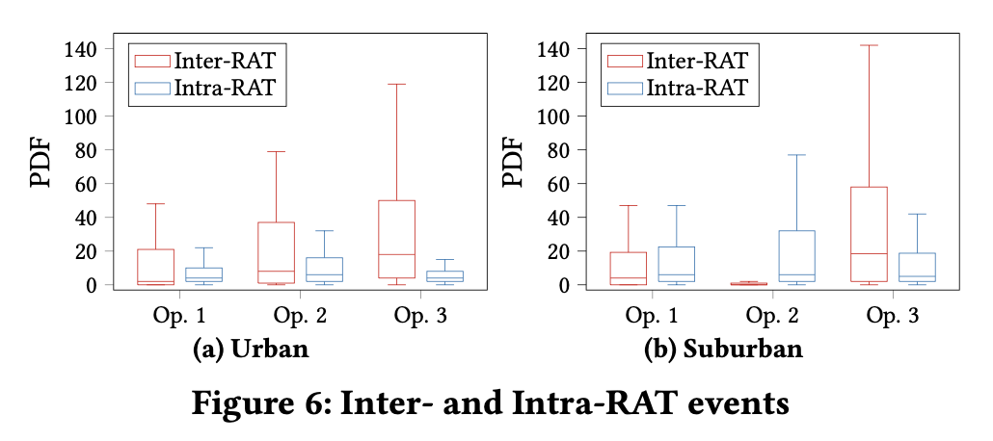
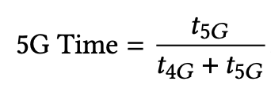
5G Time & inter-RAT HO
Figure 4: Urban users benefit from 5G connectivity more often than the suburban
Figure 5: Higher number of inter-RAT HOs in suburban areas than in urban areas, with the exception of Op. 2 because of its limited 5G deployment w.r.t. the other operators.
Count
Count

Slide 20
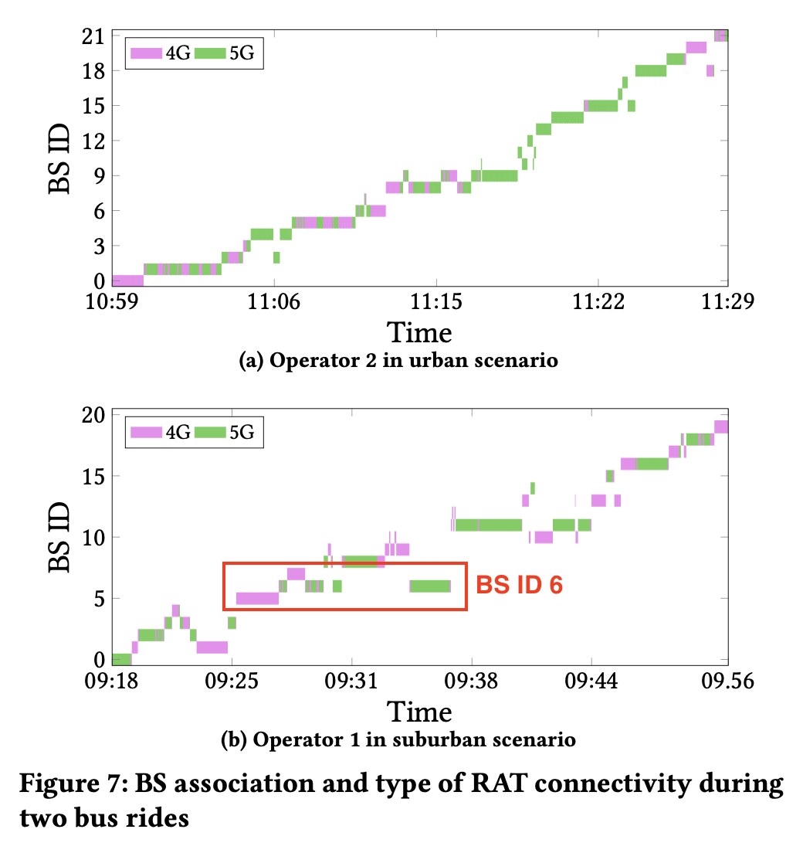
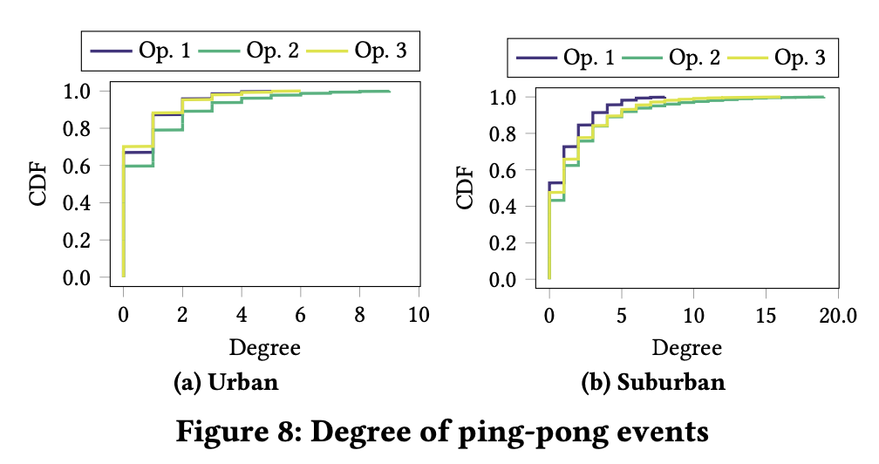
Ping Pong Effect
The bus traverse the same area at different times following the path.
A network sub-optimal handover decision is made, and this typically happens for a very short time.
Figure 7: Identify the ping pong effect.
E.g., the anonymized BS with ID 6 in Fig. 7(b) is seen four times between 09:25 and 09:31
Figure 8: PP Degree = 0 indicates no ping pong occurs under a BS.
PPs happen at least 40% and 60% of the time in urban and suburban routes respectively.

Slide 21
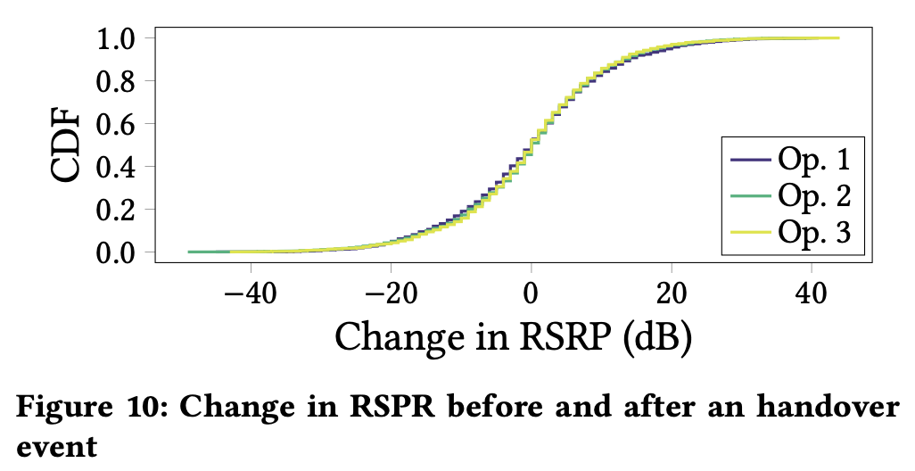
RSRP
The median of RSRP change after a handover is 0.
Indicates that it is equally probable to get an improvement or not by proceeding handover w.r.t. RSRP.

Slide 22
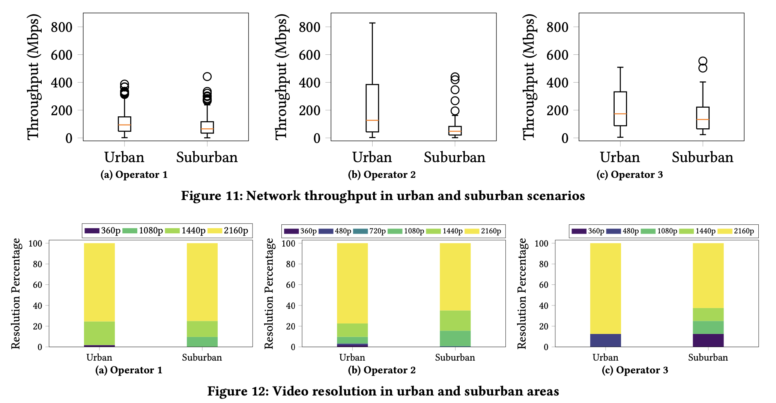
Urban vs. Suburban
Either from the perspective of throughput or the percentage of the highest video resolution (2160p) achieved during the 15-second streaming, performance in urban area is better than in suburban, with the exception of Op. 1.

Slide 23
Comparison & Conclusions

Slide 24
Comparison & Conclusions
 | 1st | 2nd
Sites | Rome (羅馬), Italy | Madrid (馬德里), Spain
Scenario | Walking & Driving | The public bus transit system
#Operators | 2 | 3
Main Focus | Handover’s cause and effects (inter-RAT HO) | Explore differences between urban/suburban and 3 operators
Inspiring statistic chart to present data (e.g., wheel chart)
The analysis in the latter part of the 2nd paper is somewhat rushed.
The definition of PP Degree in the 2nd paper is not clear.
Lacks direct numerical data to explain the reasons (e.g., why performance in urban area is better than in suburban.)

Slide 25
Authors

Slide 26
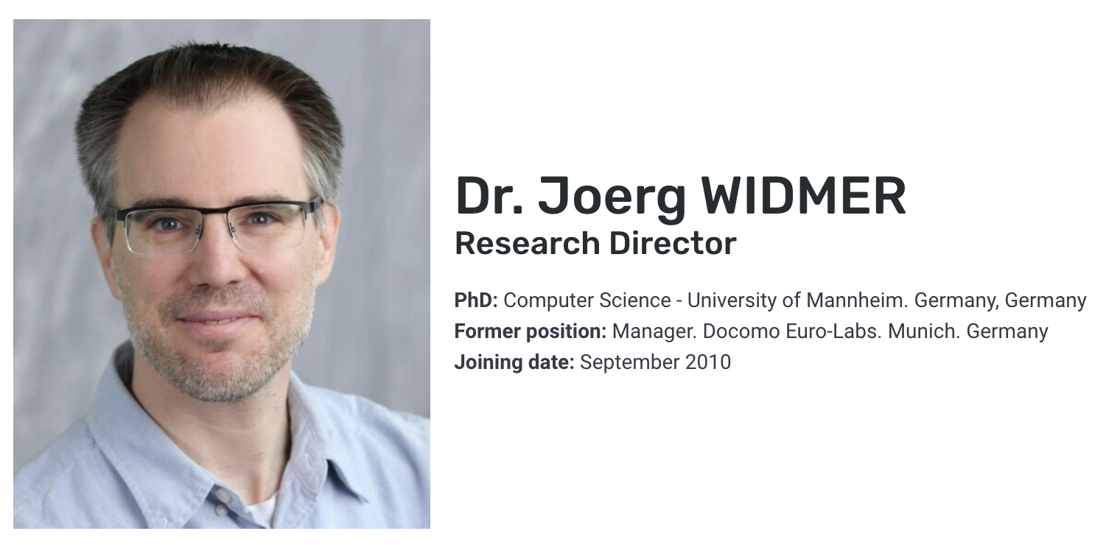
Authors of the 1st Paper
IMDEA Networks Institute Madrid, Spain
https://networks.imdea.org/organizational-structure/
第三作者（通訊作者？）

Slide 27


Authors of the 2nd Paper
Ozgu Alay, University of Oslo
https://ozgualay.com/
Maria-Gabriella Di Benedetto, Sapienza University of Rome
IEEE Fellow, 2015
http://acts.ing.uniroma1.it/about.php#work1

Slide 28
Thank You!

